Slide 1
PowerPoint hyperlinks
Make your presentation interactive
Mid-America Library Alliance
Espresso Shot Training

Slide 2
Hyperlinks: what can you do with them

Slide 3
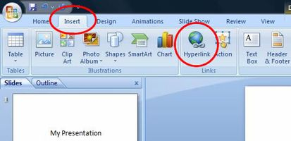
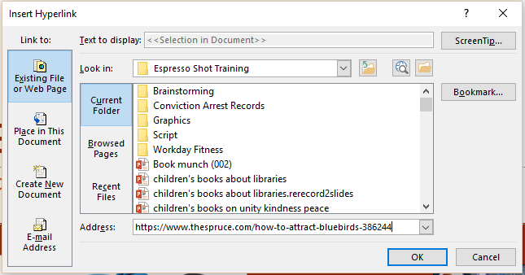
Let’s Get Started

Slide 4
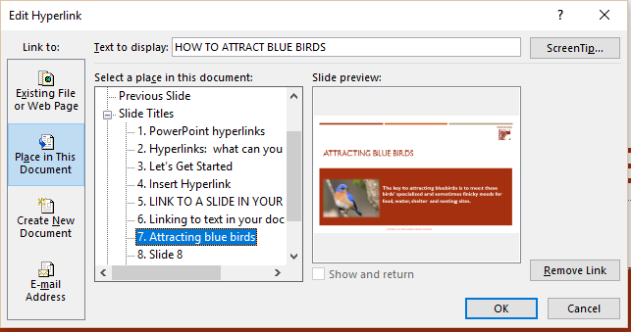
LINK TO A SLIDE IN YOUR PRESENTATION
HOW TO ATTRACT BLUE BIRDS

Slide 5
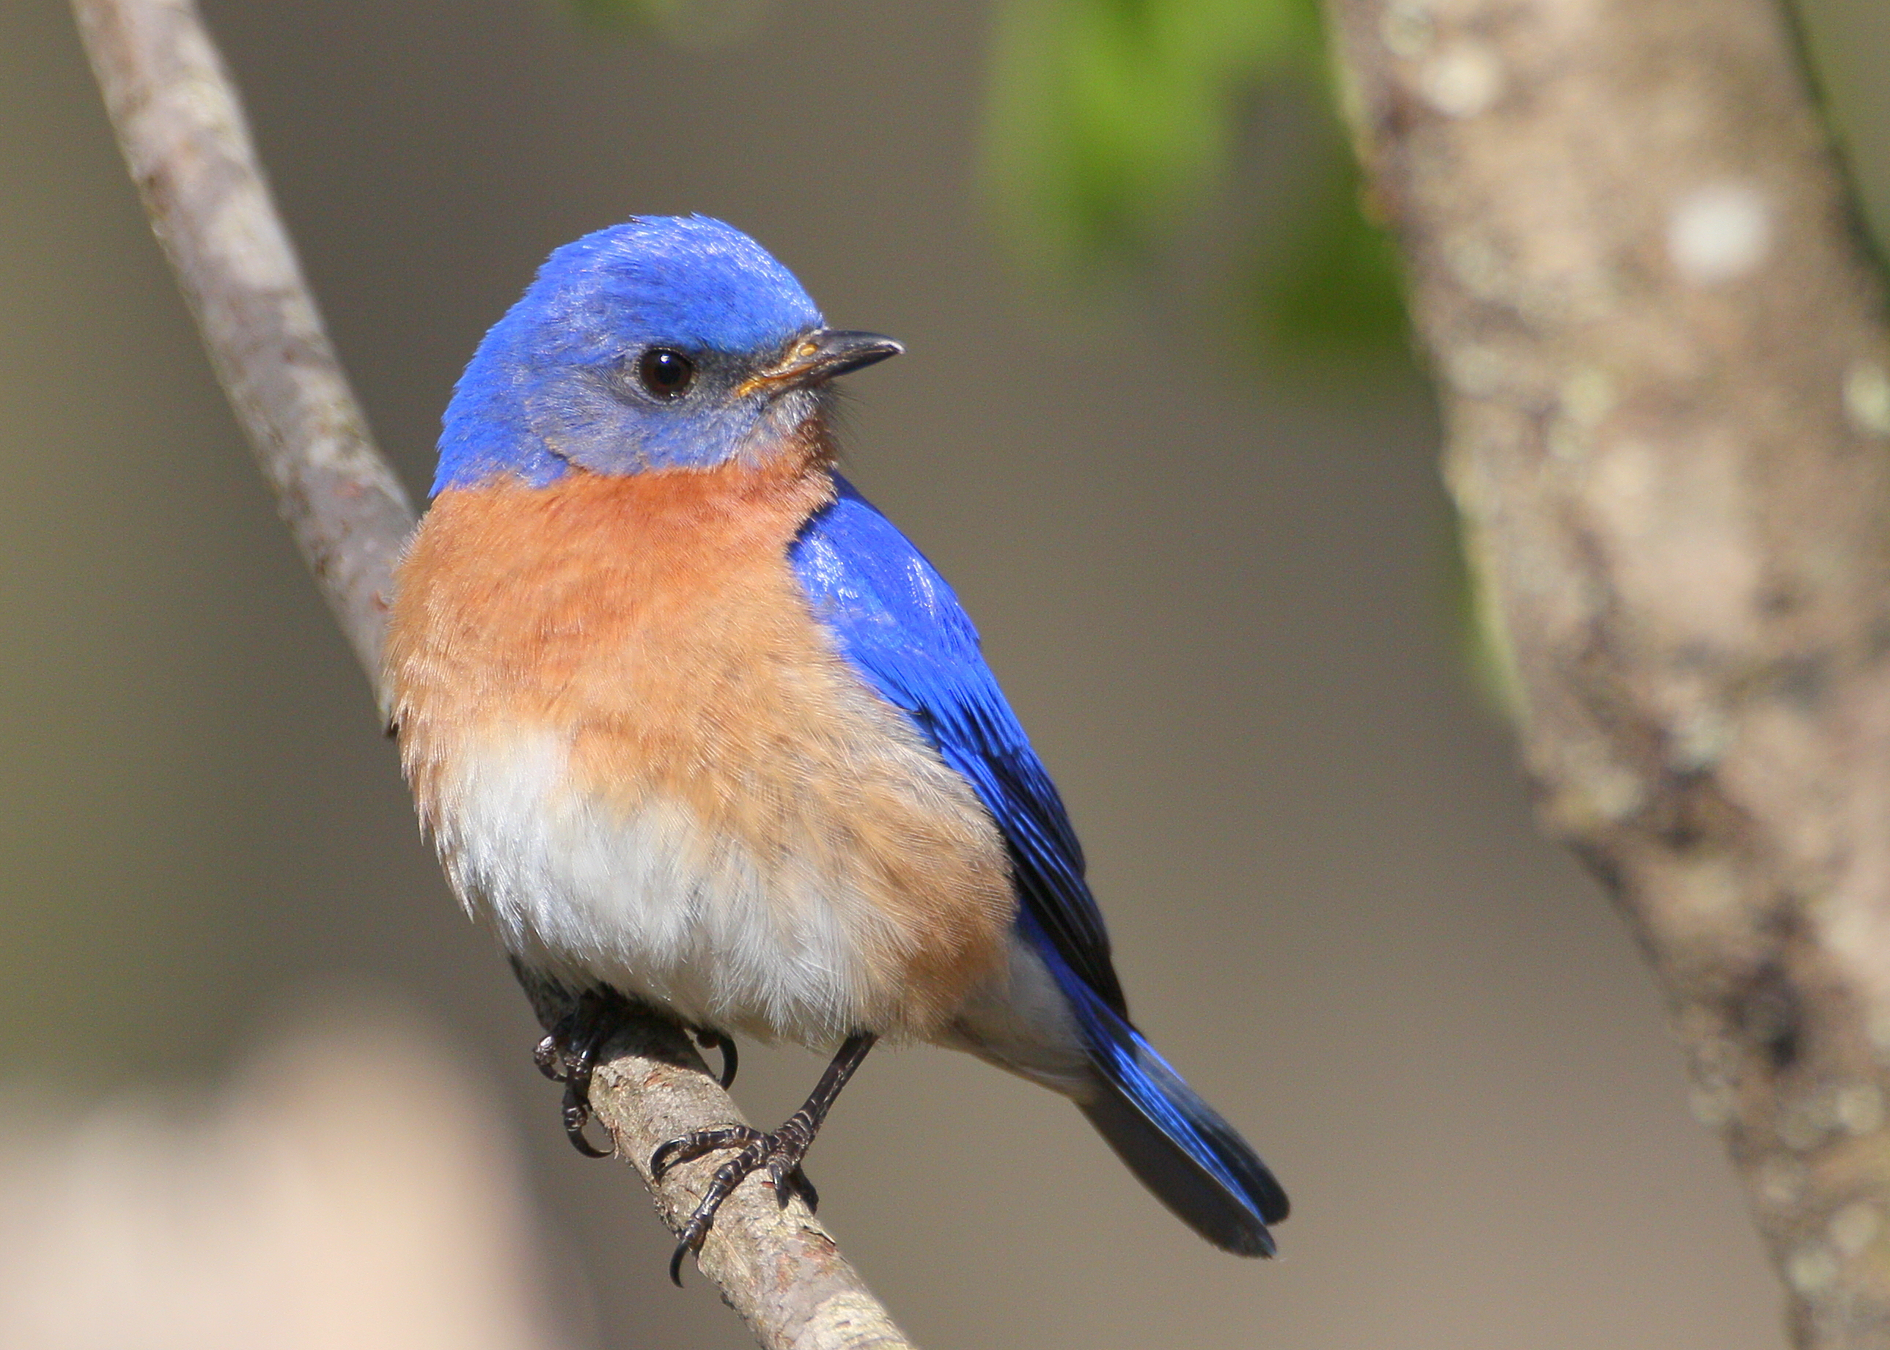
Attracting blue birds
The key to attracting bluebirds is to meet these birds' specialized and sometimes finicky needs for food, water, shelter and nesting sites.

Slide 6
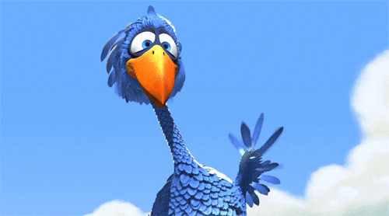
Reach an interactive level in your presentation

Slide 7
Mid-America Library Alliance
15624 E. US Highway 24
Independence, MO 64050
800-677-9699
www.mid-americalibraryalliance.org

Slide 8
Certificate of completion
________________________________________
Has completed PowerPoint Hyperlinks
A Mid-America Library Alliance Espresso Shot
Susan Burton, MALA Executive Director

