Slide 1
Public Library community engagement
Insert Your Logo
Opening Doors……Opening Minds….Opening Possibilities
Public Libraries Bring Value to the Community
Put your Footer Here

Slide 2
Your Library…..your way
If you are a reader and a book lover, you probably already use the ___________ Public Library, love it and cannot imagine life without it.
But have you truly explored all your library has to offer?

Slide 3
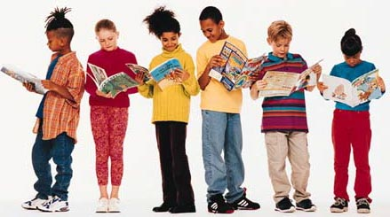
Who we are
Serves a population of _______________ in the _______hours we are open each week.
We have __________________registered borrowers
Insert “Your” Library photo and address here

Slide 4
Collections
We own over _____________ books that are offered to our community.
In addition, our borrowers used the interlibrary loan services in excess of __________________ times in the year ______ alone.

Slide 5
Programming
_____ Teen Programs
_____ Children’s Programs
______ Adult/Senior Programs

Slide 6
Public libraries support education
Students who frequently visit well stocked and well staffed libraries end up with higher ACT scores and perform better on reading and writing exams.
Public libraries provide support to schools and students.
As school budgets dwindle, public libraries have stepped up to fill the gap.

Slide 7
Healthy library healthy community
A healthy library is symbolic of a healthy community.
A community that does NOT have a good Public Library is unattractive to businesses and individuals looking to relocate to a new area.
Public libraries are an essential foundation for the community it serves.

Slide 8
Our Library…….our community
Not only are libraries the foundation of the community but also a bridge to give all patrons in their community the opportunity to experience
New ideas
Experience the arts
New skills
Networking and gathering
New hobbies

Slide 9
Why public libraries remain relevant
______________ Public Library reflects the diversity, character needs and expectations of our community.
We continue to listen, evaluate and grow to meet these needs.
We need the support of our community leaders to make this happen.

Slide 10
Invest in your public library for great returns
Investing in your public library is not a gamble but a sure bet.
Public libraries have an economic impact that greatly exceeds their cost and consistently create a positive return on investment.

Slide 11
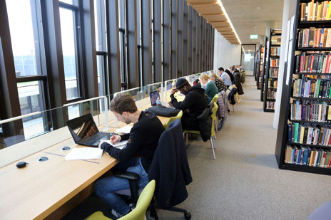
Creating Your packet
__________________ community and economy benefit when business people utilize library resources to develop skills that are transferrable to a variety of situations and are necessary to function in the 21st century workplace.

Slide 12
Our struggle is real
Public libraries continue to struggle to keep up with the constant changes in technology, and the skyrocketing costs of books, AV and databases.
Coupled with shortages in staff and budget and the growing and diversified needs of our patrons.

Slide 13
Commit to the future
As community leaders, we ask you to please make a commitment to your library and the equal access to services we provide to everyone in our community.
The intellectual and economic health of our community depends on it.
Library users today are our future leaders and decision makers of tomorrow.

Slide 14
Questions?
Name
Library Director
_________ Public Library
Address
Phone:
Web address
E-mail

