Slide 1
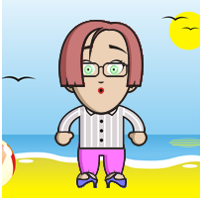
Tween Programming in your library
Make your own avatar
Mid-America Library Alliance
Espresso Shot Training

Slide 2
DoppleMe
www.doppelme.com

Slide 3
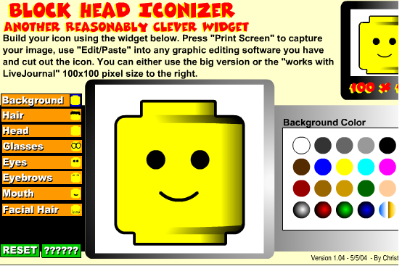
Block Head
www.reasonablyclever.com/blockhead

Slide 4
Otaku Avatar Maker
www.moeruavatar.com/index_en.shtml

Slide 5
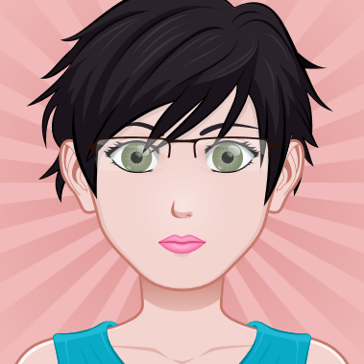
Avatar.com
http://avatarmaker.com/

Slide 6
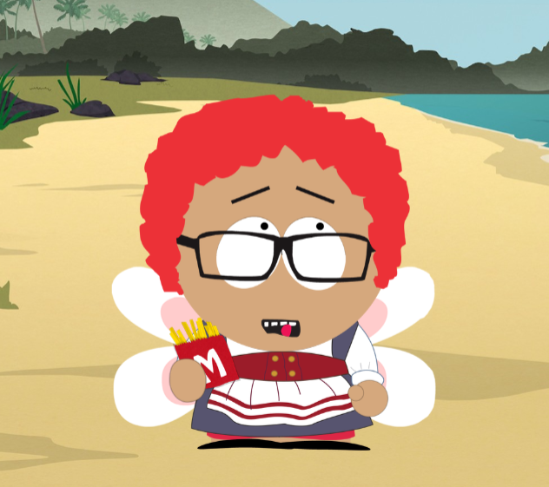
South Park Avatar
http://southpark.cc.com/avatar

Slide 7
Wrap Up

Slide 8
Mid-America Library Alliance
15624 E. US Highway 24
Independence, MO 64050
800-677-9699
www.mid-americalibraryalliance.org

Slide 9
Certificate of completion
________________________________
Has completed the Tween Programming in Your Library: How to Create an Avatar
A Mid-America Library Alliance Espresso Shot
Susan Burton, MALA Executive Director

